Slide 1

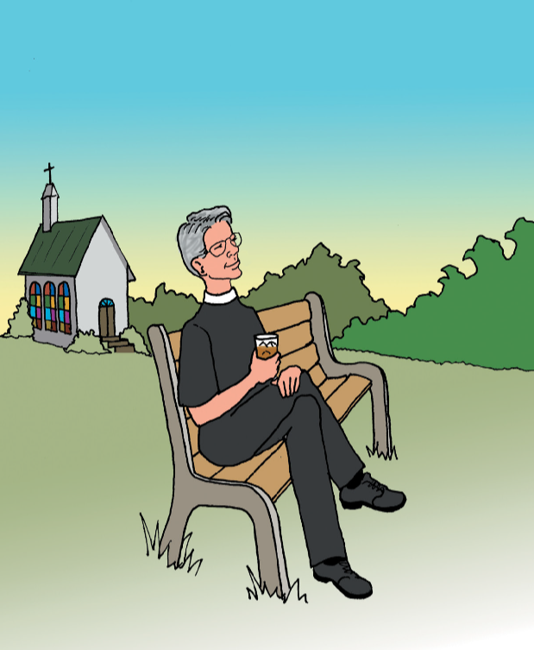
Once upon a time, inside our family church, the minister decided it was much too pretty a day to stay indoors. Therefore, he grabbed a cold drink and went to sit in the backyard of the church.

Slide 2
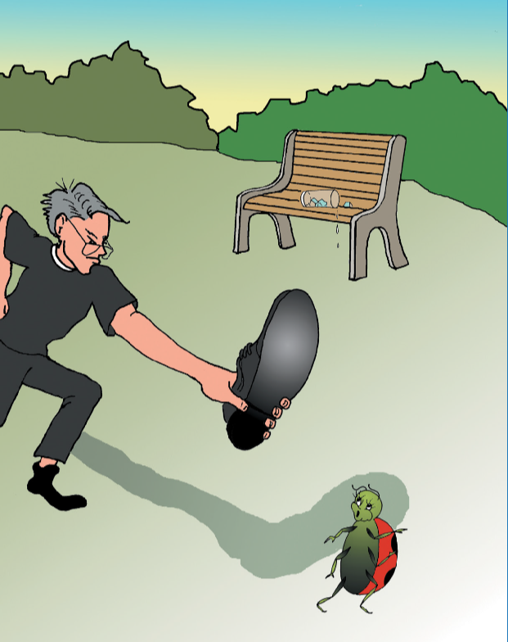
While enjoying the warm sunshine and a nice cool breeze, his content state of being was suddenly interrupted by a ladybug crawling up his leg. This startled the preacher, and he decided the best thing to do was to smash that ladybug. Linda the Ladybug, tried to get away, but even with six legs, she just could not run fast enough. So, she died.

Slide 3
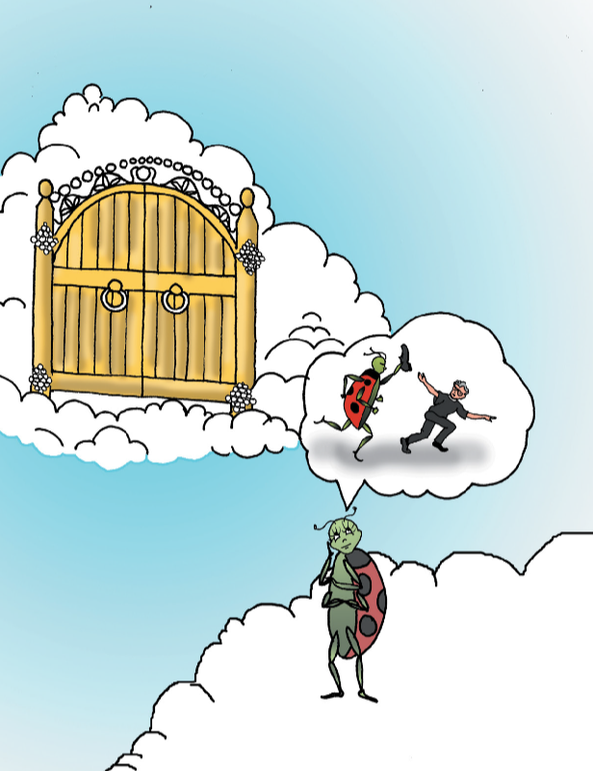
When Linda the Ladybug woke up, after being dead, she was wondering what was to become of her now? She knew that as a Christian ladybug, her soul would get to go to heaven. However, she was not truly sure what a soul was. She began to fantasize. Maybe she was now the sole of a shoe and she dreamed of chasing the minister and smashing him with a giant shoe.

Slide 4

Next, she thought, “maybe I’m not the sole of a shoe, maybe it means that I have lots of soul. This made Linda the Ladybug feel really cool! She then tries to strut her stuff by pretending to be a rap star.

Slide 5

Suddenly Linda realized she was no longer a ladybug; she had instantly been transformed into an angel. Next, Linda the Angel decides to try out her wings. Wow, this is really cool, and what was even more amazing was the incredible beauty she saw all around her. When she stopped, she could tell that she was near the entrance of Heaven, for in front of her were streets made of gold and a humongous gate of pearls.

Slide 6
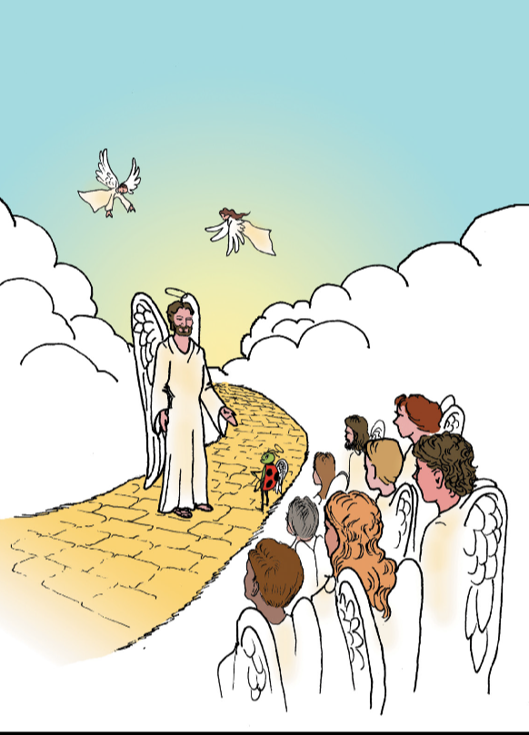
Next, she saw a really big angel, who summoned Linda to come near. He was actually trying to do a roll call of all who had died at the exact second as little Linda. Linda felt an overwhelming amount of joy when she heard her own name being read from the Lambs Book of Life. She was then welcomed into heaven with thunderous applause, from angels all around.

Slide 7

Linda the Angel soon realized, that she was no longer limited by her size and of course as a new resident of Heaven, she wanted to explore all that it had to offer. Once again, she began to try out her new wings. Flying high in the sky, she marveled at the beauty of it all.

Slide 8

She then decided to fly in for a closer look. However, Linda was not exactly an expert with her new set of wings. She unfortunately misjudged her speed and ended up landing with a mighty crash! This startled her at first, but then she began to realize that there was not a single scratch on her, because in Heaven there is no pain!

Slide 9
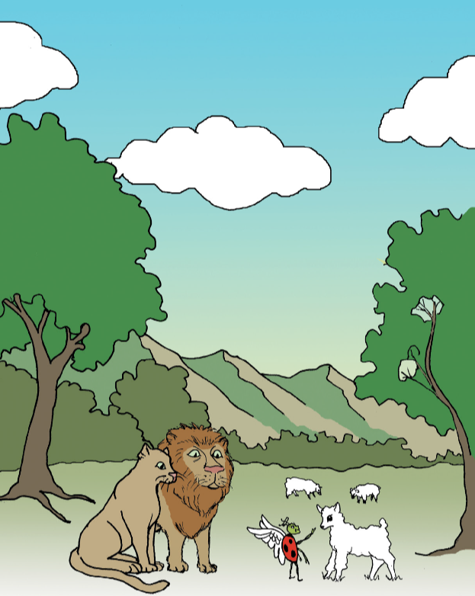
However, she wasn’t out of the woods yet, because she soon realized that she had landed among a habitation of lions. At first she was frightened, but she realized something else, among the lions were many lambs. The lions and the lambs were together in perfect peace. She then walked among them petting and playing. She even got on the back of one lion and enjoyed a fun ride.

Slide 10
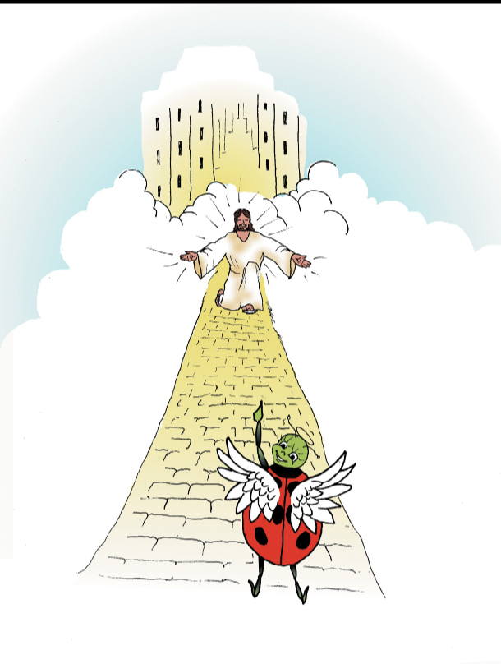
Next, Linda journeys further on the streets of gold. She soon becomes overwhelmed by the sight of seeing mile after mile of beautiful mansions. Linda’s heart becomes full when suddenly, she feels the presence of God. Then, off in the distance, she sees Jesus with His arms open wide, smiling at her. Linda, knew she was in Heaven now for in her heart she felt indescribable joy and love!

Slide 11
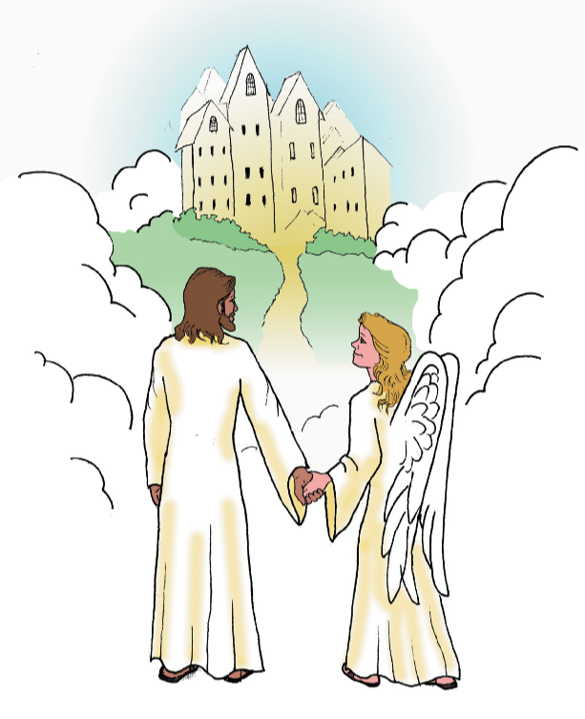
Do you know that Jesus loves you too, and that you can experience that same joy? It’s true! By accepting the love of Jesus in your heart you can know that someday you will have a home in Heaven and be able to experience His love now and forever. That is why Christians everywhere, can know without a doubt, that they will live Happily Ever After.
The End

